Slide 1
Deep Learning POC Pharmacy Use Case
TCS Confidential
March 2018

Slide 2
Deep Learning POC Table of Contents
Overall Objective
POC Use Case
What has been done so far
POC Flow
POC Demo
POC Architecture and Technology
Deeper Analysis of the Findings

Slide 3
Overall Objective
To enable key executive stakeholders to contextualize the implications of Deep Learning at Walgreens from an overall implementation standpoint
Functions that are “wired to learn”; as opposed to functions that are explicitly coded
Deep Learning
Supervised Learning
The need for labeled data for functions to learn in supervised context
Synthetic Data
Incorporation of prior knowledge into Supervised Learning
Unsupervised Learning
Resources required to satisfy the promise (and the hype)
Hardware
People
Processes
Assess Feasibility

Slide 4
Deep Learning POC Table of Contents
Overall Objective
POC Use Case
What has been done so far
POC Flow
POC Demo
POC Architecture and Technology
Deeper Analysis of the Findings

Slide 5




Pharmacy Use Case
Business Challenge
?
Solution
?
Results
?
Tools & Techniques
?

Slide 6
Deep Learning POC Table of Contents
Overall Objective
POC Use Case
What has been done so far
POC Flow
POC Demo
POC Architecture and Technology
Deeper Analysis of the Findings

Slide 7
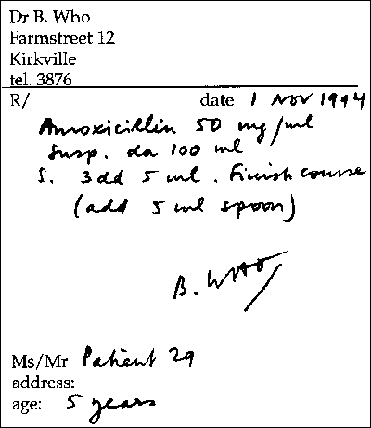




POC Flow – Approach 1
Form Segmentation
Form Segmentation
Text Segmentation
Text Segmentation
Scanned Rx Form
Scanned Rx Form
Segmented Form
Segmented Text
Segmented Form
Segmented Text
Word Segmentation
Letter Segmentation
Segmented Words
Segmented Letters
Segmentation Process

Slide 8
POC Flow – Approach 2 (End to End Text Recognition)
Detector
Recognizer
Scanned Rx Form
Segmented Form
Segmented Words
Segmentation Process

Slide 9
Deep Learning POC Table of Contents
Overall Objective
POC Use Case
What has been done so far
POC Flow
POC Demo
POC Architecture and Technology
Deeper Analysis of the Findings

Slide 10
POC Demo

Slide 11
Deep Learning POC Table of Contents
Overall Objective
POC Use Case
What has been done so far
POC Flow
POC Demo
POC Architecture and Technology
Deeper Analysis of the Findings

Slide 12

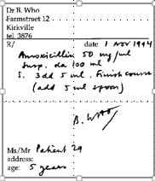

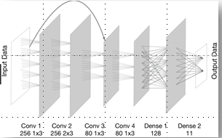











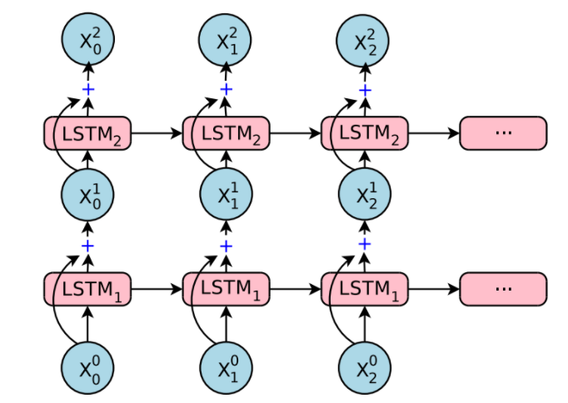
POC Technology and Architecture - 1
A
M
O
X
I
L
I
N
5
0
M
G
Scanned Prescription
Computer Vision API
Input handwritten characters
Amoxilin 50 mg
Prediction
LSTM

Slide 13
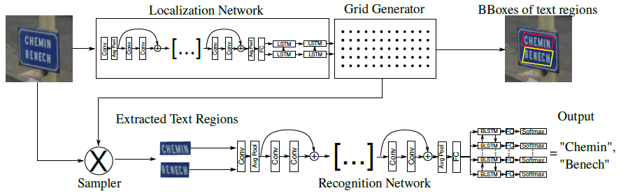
POC Technology and Architecture - II
“Amoxicillin”
“50”
“mg”

Slide 14

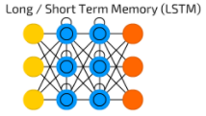


POC Architecture – Key Frameworks and Components
Deep Learning Frameworks
Computer vision API’s and Languages
Neural Network Architectures

Slide 15
POC Architecture – Key Frameworks and Components
Keras
High level neural network API with a focus on enabling fast experimentation
Keras is deep learning library that
Allows for easy and fast prototyping
Supports both convolutional and recurrent n/w
Runs seamlessly on CPU and GPU
TensorFlow
It is an open source software library for numerical computation using data flow graphs
Using TensorFlow
Computation can be deployed on one or more CPUs or GPUs
Machine learning and deep neural network research can be done

Slide 16
POC Architecture – Key Frameworks and Components
OpenCV (Open Source Computer Vision Library) is an open source computer vision and machine learning software library.
Open CV includes:
Both classic and state-of-the-art computer vision and machine learning algorithms
Common infrastructure for computer vision applications which helps accelerate the use of machine perception
Tesseract is an optical character recognition (OCR) engine with support for Unicode and the ability to recognize more than 100 languages

Slide 17
POC Architecture – Key Frameworks and Components
Neural Network Architectures
Long/ Short Term Memory (LSTM)
LSTM is one of the sequence models which are used in the field of speech recognition, natural language processing and other tasks.
LSTM overcame the limitations of Recurrent Neural Networks which does not perform for long term dependencies
ResNet
There is agreement in the deep learning community that we need to go deeper with a network architecture which is thousand of layers and still have compelling performance
Residual networks provide a method to make neural networks deeper without degrading the performance
With a more deeper network we can extract more hidden features and increase the performance of the task that the neural network is trying to achieve.

Slide 18
POC Architecture – Selected Framework Detailed Walk Through - I

Slide 19
POC Architecture – Selected Framework Detailed Walk Through - II

Slide 20
POC Architecture – Selected Framework Detailed Walk Through - III

Slide 21
Deep Learning POC Table of Contents
Overall Objective
POC Use Case
What has been done so far
POC Flow
POC Demo
POC Architecture and Technology
Deeper Analysis of the Findings

Slide 22
POC Analysis

Slide 23
Appendix

Slide 24

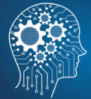
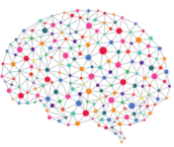
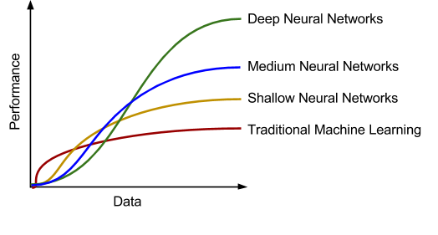
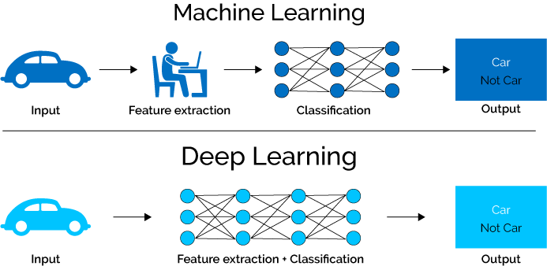
Deep Learning - Overview
Artificial Intelligence
Making intelligent machines and programs
Machine Learning
To learn without being explicitly programmed
Deep Learning
Learning based on deep neural networks
Performance Benefits
Performance gain as you feed more data
Auto feature selection
No need to accurately identify features

Slide 25
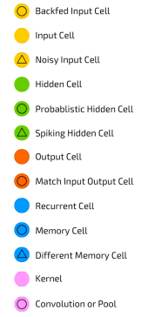
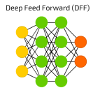
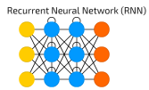

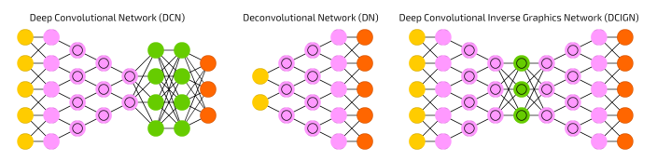
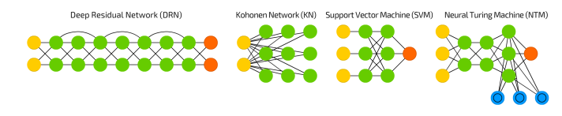
Deep Learning – Architecture (Deep Neural Nets)
CNN is the most commonly used deep NN Architecture used for image recognition problems!

Slide 26
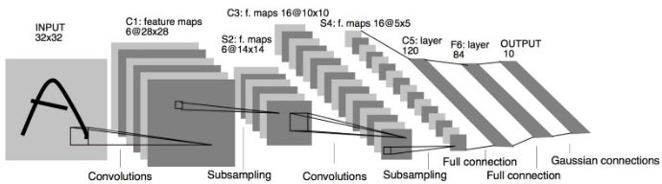
Deep Learning – CNN Architecture
CNN
LeNet
AlexNet
VGG
GoogLeNet
Inception V3
ResNet
Prominent CNN Architectures
CNN networks have evolved over the years
Each subsequent CNN is more deeper than the previous architectures
Each subsequent CNN hence is more data hungry and requires enormous computational power
LeNet
Architecture

Slide 27
Thank You

